Slide 1
Bharat Biotech

Slide 2
Introduction
Established in 1996 by Dr. Krishna M. Ella and Mrs. Suchitra K. Ella
headquartered in Genome Valley, Hyderabad, India.
Focus on product-oriented research, development, and manufacturing of vaccines and biotherapeutics, especially targeting infectious and neglected diseases
Features advanced Biosafety Level 3 (BSL3) laboratories and manufacturing facilities approved by global regulators like the USFDA, WHO, and KFDA
Bharat Biotech currently has a workforce of more than 4,000 employees, including scientists, researchers, manufacturing personnel, quality-control specialists and other professionals.
Bharat Biotech has supplied more than 10 billion vaccine doses globally and has supplied products to over 125 countries.
Bharat Biotech reports holding more than 160 global patents.

Slide 3
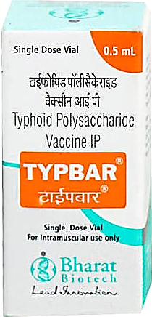
Products
Typbar TCV^{®-} (Typhoid Vi Conjugate Vaccine )
Typbar TCV® is the world’s first clinically proven conjugate Typhoid vaccine and also the first vaccine to be approved for infants below 2 years of age.
Each 0.5 mL of dose contains: Purified Vi-Capsular Polysaccharide of S. typhi Ty2 conjugated to Tetanus Toxoid: 25 µg. Pharmaceutical Form: Sterile Solution for Injection
TYPBAR-TCV® should be given intramuscularly in the anterolateral aspect of thigh in infants ≤12 months of age or in the upper arm muscle in children ≥12 months of age and adults. Single dose of any of Typhoid conjugate vaccine is recommended from 6 months onwards.
Typbar-TCV induces T-cell-dependent anti-Vi antibody and immune-memory responses against S. Typhi
The safety of Typbar-TCV® vaccine was established in phase II and III clinical trials.
In phase II, the testing was done on 100 individuals(2-17 years). The commonly observed adverse effects were fever, headache, swelling and pain at the place of injection.
In phase III, testing was done on 981 healthy subjects which were divided into two cohorts. The first group had 327 children aged 6 months to 2 years, who received one dose of Typbar-TCV®. The second group had 654 people aged over 2 to 45 years, who were randomly divided into two equal groups. One group received Typbar-TCV® and the other received a Vi polysaccharide vaccine for comparison.
Non-clinical toxicity studies of Typbar-TCV® were conducted in mice and rabbits to check its safety and tolerability. The results showed that there were no immediate allergic or anaphylactic reactions in either the vaccinated or control groups, indicating that the vaccine was well tolerated in these animal studies.
Studies on Typbar-TCV® have been conducted in several countries to evaluate its safety, effectiveness, and ability to protect against typhoid. In Nepal, a study involving about 20,000 children showed that the vaccine was safe and had 81.6% efficacy.

Slide 4
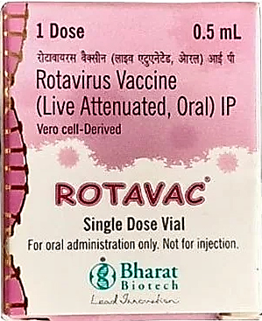
Products
2. ROTAVAC-Rotavirus Vaccine (Live Attenuated, Oral)
India’s first indigenously developed Rotavirus vaccine, derived from a naturally attenuated strain to battle severe diarrhoea in infants.
Each dose of 0.5 mL (5 Drops) contains: Rotavirus 116E Bulk, Live Attenuated: NLT 105.0 FFU Pharmaceutical Form: liquid in frozen form.
ROTAVAC® is for oral use only and SHOULD NOT BE INJECTED.
ROTAVAC uses an attenuated rotavirus strain to stimulate intestinal and systemic immunity against rotavirus.
Safety studies of ROTAVAC® from Phase Ib/IIa to Phase IV showed that the vaccine was generally well tolerated. In the Phase Ib/IIa trial, 369 infants aged 6–8 weeks were studied; the common side effects were fever, vomiting, and diarrhoea, with no significant vaccine-related adverse events.
In the larger Phase III trial, 6,799 infants aged 6–7 weeks participated, and adverse events such as fever, vomiting, diarrhoea, cough, runny nose, irritability, and rash occurred at similar rates in the vaccine and placebo groups. No vaccine-related serious adverse events or deaths were reported.
In Phase IV, 900 infants were studied in three groups, and the occurrence of adverse events was similar across all groups. Overall, the clinical studies showed no major safety concerns associated with ROTAVAC®.
The recommended storage temperature for ROTAVAC® is at -20°C or below until the expiry date indicated on the vial. It can be stored for up to six months between +2°C and +8°C. ROTAVAC® can be subjected to 6 freeze- thaw cycles.

Slide 5
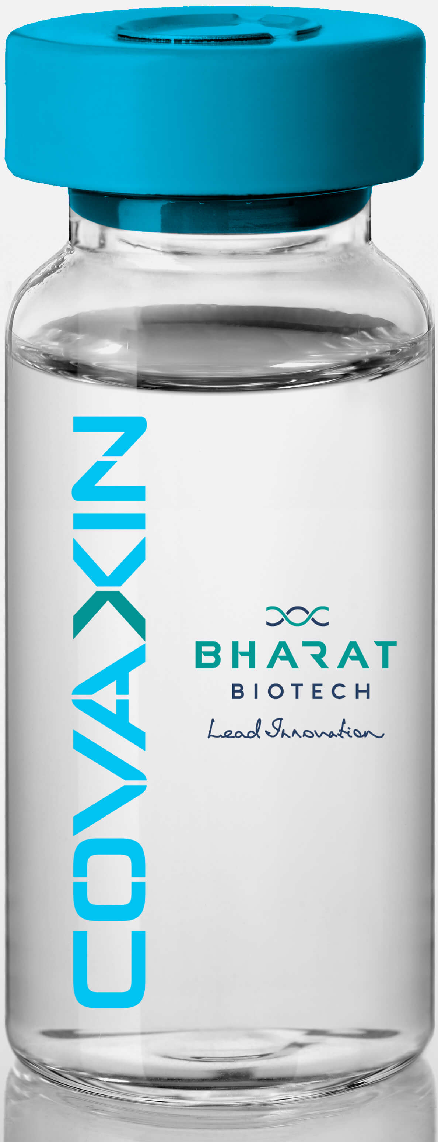
Products
3. COVAXIN® (Whole Virion Inactivated Coronavirus (SARS-CoV-2) Vaccine)
COVAXIN®, India's indigenous COVID-19 vaccine by Bharat Biotech is developed in collaboration with the Indian Council of Medical Research (ICMR) - National Institute of Virology (NIV).
developed using Whole-Virion Inactivated Vero Cell derived platform technology
pharmaceutical form :Sterile suspension for injection
COVAXIN® is approved for active immunization against SARS-CoV-2 (COVID-19) in individuals aged 18 years and above. It is also permitted for restricted emergency use in children above 6 to 18 years of age, as authorized by the DCGI.
COVAXIN® should be administered as two doses on Day 0 and Day 28. Method of administration: Intramuscular injection (IM)
COVAXIN shows the immune system a non-replicating version of the virus, allowing it to learn how to recognize the virus and respond more rapidly if exposed to SARS-CoV-2 later.
Demonstrated strong immunogenicity and protective efficacy in animal challenge studies conducted in hamsters & non-human primates
COVAXIN® (BBV152) was evaluated through three main clinical trial phases. In Phase 1, 375 healthy adults aged 18–55 years participated. The most common side effects were injection-site pain, headache, fatigue, fever, and nausea/vomiting, and most were mild or moderate.
In Phase 2, 380 participants aged 12–65 years were enrolled and received either a 3 µg or 6 µg vaccine formulation. The most common side effect was injection-site pain, and most adverse events were mild and resolved within 24 hours.
In Phase 3, 25,798 participants were monitored for safety. Adverse events were generally mild, and their frequency was similar between the COVAXIN® and placebo groups

Slide 6
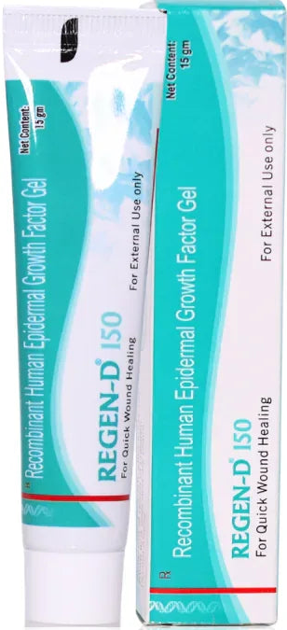
Products
4. REGEN-D 150
REGEN-D® was India’s first recombinant epidermal growth factor gel utilized globally for fast and effective wound healing in diabetic foot ulcers and severe burns.
Each gram of gel contains Purified Bulk of rh - Epidermal Growth Factor: 150μg. Pharmaceutical Form: Gel
Cleanse the ulcer wound and surrounding surface with water or saline and pat dry with sterile cotton before the gel is applied. Apply the gel evenly on the affected area of the skin using sterile cotton swab twice a day till the ulcer area heals. REGEN-D® 150 therapy should be continued up to a period of 2 to 3 weeks after the wound heals.
REGEN-D® 150 has proven low reactogenicity and is well tolerated, however, skin irritation/pain rash at the application site may be seen in very few cases.
Pre-clinical studies of recombinant human Epidermal Growth Factor (rh-EGF) were conducted in rats and rabbits using repeated topical doses of 75–300 µg/kg. The studies found no significant toxicity, systemic absorption, or antibody response, while increases in DNA and collagen content were observed in treated skin.
In Phase 3 clinical studies, REGEN-D® 150 was tested for diabetic foot ulcers and pressure ulcers. For diabetic foot ulcers, healing occurred in about 9 weeks with REGEN-D® 150 compared with 13 weeks with placebo, with around 84–86% of ulcers healed by 15 weeks compared with about 50% with placebo.
For pressure ulcers, healing took about 40 days with REGEN-D® 150 compared with 78 days with placebo. The treatment was generally well tolerated, with only minor reactions such as rash or irritation reported and no serious drug-related adverse reactions.

Slide 7
Challenges
Competition
Bharat Biotech operates in a competitive vaccine market, with companies such as the Serum Institute of India and Biological E also developing and supplying vaccines. Increased competition can affect pricing, government procurement shares and market opportunities.
High Capital Expenditure
Bharat biotech have moved beyond traditional vaccines towards advanced therapeutics- Tuberculosis, Nipah, Ebola, chikungunya etc. Developing such products requires substantial investment in research, clinical trials, manufacturing facilities and regulatory compliance. At the same time, vaccines supplied through public-health programmes can involve significant price and procurement constraints.
Reputation and Public Trust Risk
The development and emergency authorization of COVAXIN during the COVID-19 pandemic generated public debate, particularly because the authorization came before the Phase III efficacy results had been published. WHO subsequently granted COVAXIN Emergency Use Listing in November 2021 after reviewing available evidence.
Regulatory challenge
Bharat Biotech faced regulatory difficulties in Brazil during the COVAXIN approval process. In April 2021, ANVISA rejected the application for importation of COVAXIN after its assessment identified issues concerning documentation and the manufacturer's Good Manufacturing Practices certification

Slide 8
Application
Bharat Biotech’s primary application is the production of vaccines
Typbar TCV® is the world’s first typhoid conjugate vaccine used to prevent typhoid fever in infants and adults. ROTAVAC® is widely used to prevent severe rotavirus diarrhoea in infants
COVAXIN® and iNCOVACC® (the world's first intranasal COVID-19 vaccine) are applied to combat SARS-CoV-2.
Vaccines like JENVAC® protect against Japanese Encephalitis, while Indirab® is applied as a post-exposure treatment for Rabies. They also develop preventative vaccines for Zika and Chikungunya.
Production of Biopolio® (Oral Polio Vaccine) and vaccines like Comvac 5® (Pentavalent vaccine) protect infants from Diphtheria, Tetanus, Pertussis, Hepatitis B, and Hib
Bharat Biotech use Recombinant DNA technology to create Bio-Therapeutics
REGEN-D® is a recombinant human epidermal growth factor gel applied topically to accelerate the healing of chronic diabetic foot ulcers. It also applied to speed up tissue regeneration in patients with first- and second-degree burns or skin grafts.
SLVRGEN® are used as specialized ionic silver gels to treat wounds and prevent bacterial infections in open skin trauma

Slide 9
Application
Regenerative & Personalized Medicine
Developing targeted viral-vector designs to treat genetic disorders and rare conditions.
Researching cell-culture modifications to manufacture custom, personalized treatments for oncology (cancer care) and tissue regeneration.
Probiotics & Gastrointestinal Health
Through products like Biogit®, they apply specific therapeutic probiotic yeast strains (Saccharomyces boulardii) to manage gut health, balance internal flora, and treat acute diarrhoea

Slide 10
Market Impact
Before Typbar TCV®, typhoid vaccines required booster doses and were unsuitable for infants under two years old. Bharat Biotech’s vaccine provided protection for infants as young as 6 months. Offered at public health prices of ~$1.50 per dose (compared to Western alternatives costing over $30 in private markets), it forced a global market reset.
Prior to ROTAVAC®, two multinational pharma giants dominated the global rotavirus vaccine market with prices exceeding $5–$15 per dose. Bharat Biotech launched ROTAVAC® at $1.00 per dose, cutting the cost of rotavirus prevention by over 70% globally and expanding public access across Asia and Africa.
Bharat Biotech entered a milestone technology-transfer agreement with GlaxoSmithKline (GSK) and PATH to scale up manufacturing of the RTS,S/AS01 malaria vaccine. By taking over production, Bharat Biotech is driving down costs for LMICs
As a key supplier to UNICEF, PAHO (Pan American Health Organization), and Gavi, the company provides sustainable, low-cost immunizations that save global health agencies hundreds of millions of dollars in procurement budgets.
the Indian pharmaceutical industry focused primarily on generic small-molecule drugs. Bharat Biotech pushed the industry toward first-in-class biologics and novel platforms (e.g., world's first thiomersal-free Hepatitis-B vaccine, novel adjuvants like TLR7/8 agonists, and needle-free intranasal delivery platforms).
Total doses delivered
>10 Billion
Global Footprint +125 countries
Annual Production Capacity
4 Billion

